Slide 1
Lecture 17:
Dynamic Modeling (2)
Objects, State and Events
http://www.youtube.com/watch?v=XgNKaD6UQM0

Slide 2
Developing the Dynamic Model
Creating a dynamic model by
preparing interaction diagrams
  sequence diagrams
  collaboration diagrams
identifying events between objects from these
building a state diagram
Notes:
UML uses the term interaction diagrams to cover sequence diagrams and collaboration diagrams.
The point of these diagrams is to identify associations between classes required to support behaviour. So information will be transferred from these diagrams to the class daigrams.
I began the lecture by informally sketching on the board a seqence diagram to show the passing of messages between objects and a collaboration diagram to show haw the messages are played out on the object model.

Slide 3
A Software Development Methodology
Analysis Phase
User Requirements
Use Cases
Specification
Names of things
Names of relationships
Names of actions
Notes:
Three Models: Object Model, Behavioural Model, Functional Model.

Slide 4
A Software Development Methodology
Design Phase
Names
Specification
Relationships
Actions
Use Cases
Objects
obj1
obj2
obj3
Behaviour
object1 object 2 object 3
Classes
message
Developed Model
Code
Notes:
Three Models: Object Model, Behavioural Model, Functional Model.
What is missing?
testing
Developed model is not a final diagram it is the collection of everything

Slide 5
The concepts of state and event
The two concepts of state and event are complementary
  The state of a system is changed by the events that affect the system
  A particular state is reached because of the occurrence of one or more series of events (its history).
  The behaviour of a system in response to an event is determined by the state of a system, determined by its history.
For example, the state of a bank account is given by its balance
  Deposit and withdrawal events alter the balance if the account is in credit
  A particular balance is achieved by a series of events
  Withdrawal events do not alter the balance if the account balance is too small

Slide 6
Events
Happen at a point in time.
Capture the concept of some distinct “happening” by punctuating the flow of time.
Separates the flow of time into before and after.
Carries a message to or from the system.
Events and messages may be ignored by the system.
Notes:
Note that events and messages are closely related concepts.
A message is an event which carries information in addition to the fact of the event.

Slide 7
Events & Messages
A message is an event which carries additional information.
Example:
Event vs. Message: “Button Up” vs. “Button Up”, Purchase_Button01, parts order 110295.
Notes:
Note that events and messages are closely related concepts.
A message is an event which carries information in addition to the fact of the event.

Slide 8
State
Objects contain data held in variables which can take on different values from time to time.
Some (or all) of this data determine what the object will do in response to a future event.
A valid state is defined by a valid combination of attribute values.
The data which make future behaviours differ in response to the same sequence of events is called the State of the object.
In a finite object, there can only be a finite number of states. Hence given arbitrary sequences of events, we must eventually visit states which have occurred before.

Slide 9
State
Every state is known.
State types:
  Valid – Attribute values are in agreement.
  Impossible – Breaks the laws of logic
    Not mutually exclusive
  Illogical – Runs the wrong function given specific attribute values
Multiple attribute value combinations can have the same state.
States are not always coded into a system

Slide 10
State - Purpose
To identify when valid functions can run
To identify the output/effect of the functions.
To avoid illegal states! errors →
  Unending loops
  Crashes
  Improper output
Example: Medicine drip machine

Slide 11
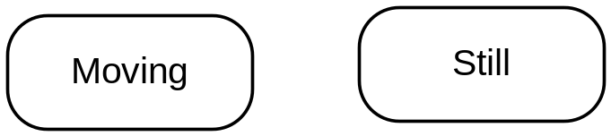
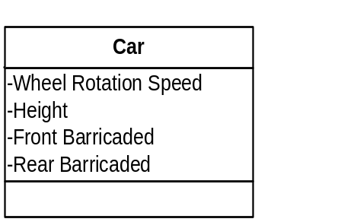
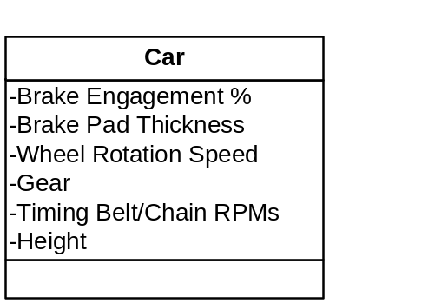
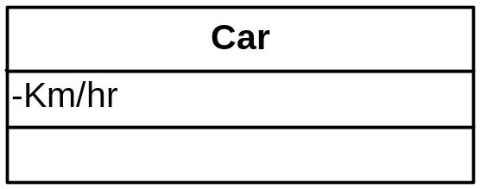
State
Identify potential states by choosing which groups of attributes and their value range.
  Flag
  Example:

Slide 12

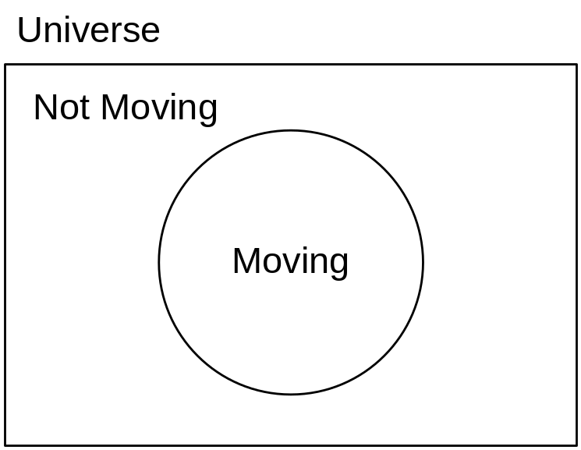
State
Mutually Exclusive
  States are unique
  Can’t be in two states at the same time.
    Excepting super- and sub-states
  Venn diagrams
  Decision Tables

Slide 13
State Diagrams
Represent a single object’s life.
Represents time to a certain degree
Show the events that an object can detect throughout its lifetime
Show an object’s responses to events
Notes:
A state is represented by a rounded rectangle.
It is labelled with a name (State 1 in the diagram) and with activities and actions.
An activity is on-going while in that state
An action is a short term activity in response to entering and leaving the state or an event which does not change the state
A state transition is represented by an arrow between states
The transition is labelled with
the event which causes the transition
(attributes) associated with the event (optional)
[a condition] which allows the transition only if true
/an action which is performed in response
The notation also allows for new events to be generated and sent to other objects.
The class of the object handles has code to handle the event (= message)

Slide 14
State Diagrams
A state is represented by a rounded rectangle.
  It is labelled with a name (State 1 in the diagram) and with activities and actions.
  Frequently an adverb (ends in –ing)
A state transition is represented by an arrow between states. It is labelled with
  the event which causes the transition
  the event generally occurs multiple times and a state may be entered multiple times.
  (attributes) associated with the event (optional)
  [a condition] which allows the transition only if true
  /an action which is performed in response
The notation also allows for new events to be generated and sent to other objects.
The class of the object handles has code to handle the event (= message)
Moving
entry/action1
do: activity1
event/action2
exit/action2
Not-Moving
event1(attributes1)/action
When
on
Functions
Notes:
A state is represented by a rounded rectangle.
It is labelled with a name (State 1 in the diagram) and with activities and actions.
An activity is on-going while in that state
An action is a short term activity in response to entering and leaving the state or an event which does not change the state
A state transition is represented by an arrow between states
The transition is labelled with
the event which causes the transition
(attributes) associated with the event (optional)
[a condition] which allows the transition only if true
/an action which is performed in response
The notation also allows for new events to be generated and sent to other objects.
The class of the object handles has code to handle the event (= message)

Slide 15


Initial and Terminal States
Initial
  Corresponds to the creation of the object
  No Name on the 1 transition leading from it.
Terminal
  The destruction of an object
  Does not respond to events
  Multiple routes can lead there.
Moving
entry/action1
do: activity1
event/action2
exit/action2
Not-Moving
event1(attributes1) /action
Notes:
A state is represented by a rounded rectangle.
It is labelled with a name (State 1 in the diagram) and with activities and actions.
An activity is on-going while in that state
An action is a short term activity in response to entering and leaving the state or an event which does not change the state
A state transition is represented by an arrow between states
The transition is labelled with
the event which causes the transition
(attributes) associated with the event (optional)
[a condition] which allows the transition only if true
/an action which is performed in response
The notation also allows for new events to be generated and sent to other objects.
The class of the object handles has code to handle the event (= message)

Slide 16
Guard Conditions
Determines which state transition happens given an event
Shown in square brackets
Moving
entry/action1
do: activity1
event/action2
exit/action2
On Raise Signal (car1)[PassengerCount < 1]
/liftVehicle( )
Not-Moving
Notes:
A state is represented by a rounded rectangle.
It is labelled with a name (State 1 in the diagram) and with activities and actions.
An activity is on-going while in that state
An action is a short term activity in response to entering and leaving the state or an event which does not change the state
A state transition is represented by an arrow between states
The transition is labelled with
the event which causes the transition
(attributes) associated with the event (optional)
[a condition] which allows the transition only if true
/an action which is performed in response
The notation also allows for new events to be generated and sent to other objects.
The class of the object handles has code to handle the event (= message)

Slide 17
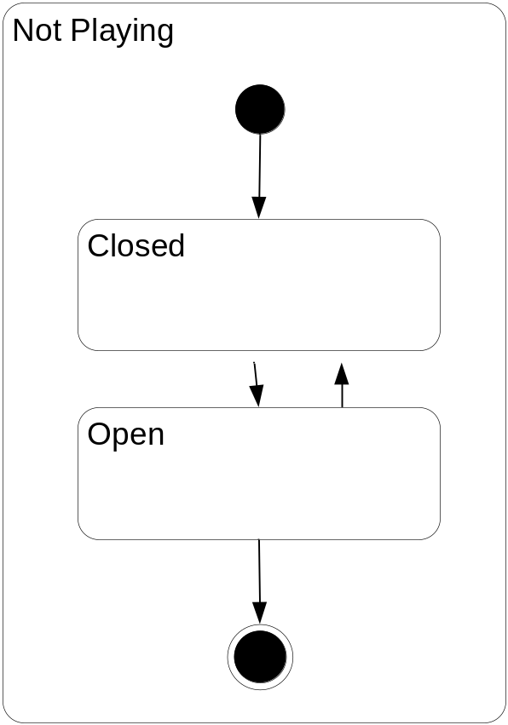
Composite States
Super- and Sub-states can exist.
A super state can be entered and exited.
Super-states can contain initial and terminal states.
Internal transitions are possible.
Notes:
A state is represented by a rounded rectangle.
It is labelled with a name (State 1 in the diagram) and with activities and actions.
An activity is on-going while in that state
An action is a short term activity in response to entering and leaving the state or an event which does not change the state
A state transition is represented by an arrow between states
The transition is labelled with
the event which causes the transition
(attributes) associated with the event (optional)
[a condition] which allows the transition only if true
/an action which is performed in response
The notation also allows for new events to be generated and sent to other objects.
The class of the object handles has code to handle the event (= message)

Slide 18
Example – Parking Permit Machine
coin_received(coin)[coin.valid]/coin_box.hold(coin)
state_1
state_2
initialise(value)
hold(coin)
set_state(state_2)
:TOTALISER
:COIN_BOX
:COIN_RECEIVER
class STATE_1
feature
on_coin_received(coin: COIN) is
-- event handler
do
if coin.valid then
create totaliser.initialise(coin.value)
coin_box.hold(coin)
coin_receiver.set_state(state_2)
end
end
end
class STATE_1 has an event handler which responds to the event “on_coin_received”.
The body of the code is only executed if coin.valid is True.
Notes:
class STATE_1 has an event handler which responds to the event “on_coin_received”.
The body of the code is only executed if coin.valid is True
If so,
an object of the TOTALISER class is created and initialised
the coin is held in the coin_box
the coin receiver changes its state to STATE_2

Slide 19
Example 2
State Diagram to detect the sequence “AB”:
“A” received
State 1
State 2
“B” received/Accept
“B” received/Reject
“A” received/Reject
State Diagram to control a heater:
room_cold/turn_on_gas
GAS OFF
GAS ON
feed_gas
room_hot
room_cold
room_hot/turn_off_gas
Notes:
These are the same state diagram, but the first is somewhat abstract.

Slide 20
Getting to code
Method 1: Use a variable to represent state
class HEATER_CONTROL
feature
gas_off, gas_on: INTEGER is unique
state: INTEGER
initialise is
do
state := gas_off
end
on_cold is
do
if state = gas_off then
state := gas_on
end
feed_gas
end
on_hot is
do
if state = gas_on then
state := gas_off
end
end
end – HEATER_CONTROL
Notes:
Here, a routine is provided for each event.
Notice that the routine checks the state and determines an appropriate action.

Slide 21
Getting to code
Method 2: Use classes to represent state
class HEATER_CONTROL
feature
state: STATE
initialise is
do
create {GAS_OFF} state
end
set_state(s: STATE) is
do
state := s
end
on_cold is
do
state.on_cold
end
on_hot is
do
state.on_hot
end
deferred class STATE
feature
on_cold, on_hot is deferred end
end
state: STATE
class GAS_OFF
feature
gas_on: GAS_ON
on_cold is
do
heater_control.
set_state(gas_on)
end
on_hot is
do
-- nothing
end
end
class GAS_ON
feature
gas_off: GAS_OFF
on_cold is
do
feed_gas
end
on_hot is
do
heater_control.
set_state(gas_off)
end
end
Notes:
Here, a routine is provided for each event.
Notice that the routine checks the state and determines an appropriate action.

Slide 22
Techniques of State Diagram Drawing
Consider only one sequence of events at a time.
  Take a single sequence and define a simple state diagram which represents that sequence only.
Gradually build up a complete description of the required state diagram.
  Further sequences of events can then be integrated into the preliminary state diagram.
Individual sequences of events can be obtained from interaction diagrams (sequence diagram, collaboration diagram)
  The messages arriving at an individual object, when arranged in the order in which the object receives them, make up such a sequence.

Slide 23
Example
Select a ticket before paying
ticket
coin
coin
coin
Preliminary state diagram for the ticket machine
coin (amount) [not enough]
Idle
ticket (cost)
Paying
for Ticket
coin (amount) [enough]
/ issue ticket and change
A more refined state diagram

Slide 24
Interaction Diagram Vs. StateChart
Interaction Diagrams:
  Inter-object behaviour
  Describes the order of functions
  Describes a use case
State Charts:
  Internal object behaviour
  Valid messages an object can receive given its state.
  Object responses

Slide 25
Summary
These are fairly simple examples, but more complex ones can use the same structures
State modelling works best when the behaviour of a single class is of concern
  N.B. We have implemented a state machine applying to the HEATER_CONTROL class by using multiple STATE classes
Dynamic behaviour may be captured using various models which may then be mapped into code.

Slide 26
Conclusion
http://www.agilemodeling.com/essays/umlDiagrams.htm
http://www.youtube.com/watch?v=1wGdaFf4t18
Basketball transition

Slide 27
Readings
Mark Priestley: “Practical Object-Oriented Design with UML”
  Chapter 9: Interaction Diagrams (2nd edition)
  Chapter 10: Statecharts (2nd edition)
  or
  Chapter 7: Interaction Diagrams (1st edition)
  Chapter 8: Statecharts (1st edition)

Slide 28
Composite States
Super- and Sub-states can exist.
A super state can be entered and exited.
Super-states can have initial and terminal states.
Internal transitions are possible.
State1
do: activity1
entry/action2
exit/action3
event/action4
State 2
…..
event1(attributes1)[condition]/action
event2(attributes2)
object
Notes:
A state is represented by a rounded rectangle.
It is labelled with a name (State 1 in the diagram) and with activities and actions.
An activity is on-going while in that state
An action is a short term activity in response to entering and leaving the state or an event which does not change the state
A state transition is represented by an arrow between states
The transition is labelled with
the event which causes the transition
(attributes) associated with the event (optional)
[a condition] which allows the transition only if true
/an action which is performed in response
The notation also allows for new events to be generated and sent to other objects.
The class of the object handles has code to handle the event (= message)

